Slide 1
STUDENT REPORT CARD SYSTEM
MOHAMMAD ABDUL IMRAN (17R01A05E7)
MOHD SUBHAN (17R01A05E9)
MANDALA SHIVA KUMAR (18R05A0525)
SAARA SANTOSH GOUD (18R05A0535)

Slide 2
INTRODUCTION :
The Project STUDENT REPORT CARD SYSTEM Includes facilities of registration, search, display, modification, deletion of student information about the marks and their name and roll number.
This software searches the student information on the basis of roll number which is stored in the record.
The software used for small schools for maintaining their records related to report card and marks of student and cost savings

Slide 3
ABSTRACT
Student report card system project in C and C++ is a simple console application built without the use of graphic in this project , users can perform typical report card related functions like adding a new student record and displaying , modifying and deleting it . File handling has been effectively used to perform all these.
This project will teach you how to use file handling in C and C++ , add , read , display , modify and delete record from file.

Slide 4
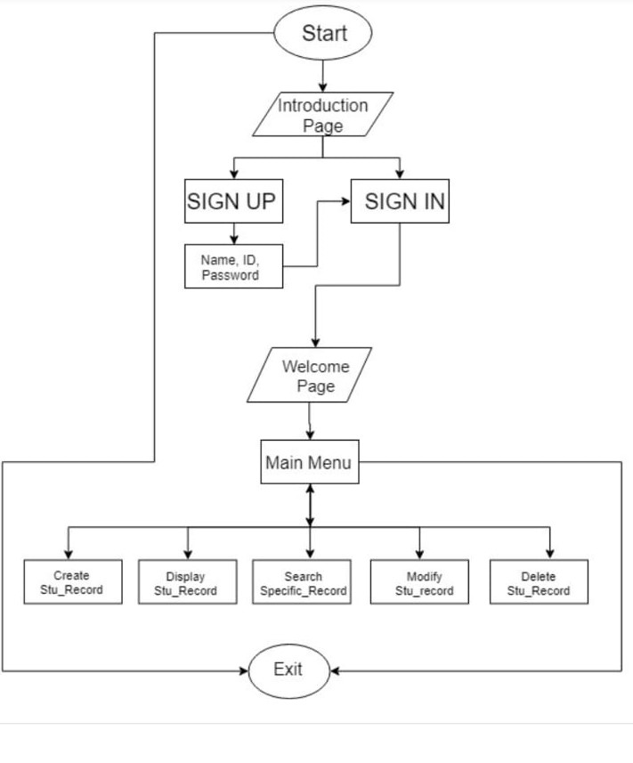
FLOW CHART :

Slide 5
SOFTWARE REQUIREMENTS :
Operating system : Windows 7 or any flavour of windows, Linux and Mac
Turbo c++ : for execution
MS-WORD : for presentation of output

Slide 6
HARDWARE REQUIREMENTS :
Processor : Intel
RAM : 512 MB or more than 512 MB
Hard disk : 40 GB
COMPACT DRIVE
Printer to print the required documents of the project .

Slide 7
ADVANTAGES :
We can edit the marks of the students easily and generate the report again.
It saves the time of the teacher to calculate the percentage and the grade or rank and pass or fail.
This software reduce paper work.
It is easy to handle student's record.
This software saves the time and Information of each student stores permanently.

Slide 8
DISADVANTAGES :
This System is suitable for only small schools.
Online facility is not available.

Slide 9
CONCLUSION :
This software is efficient in maintaining student's details and can easily perform operation on student's records.
This software also reduces the work load of the teachers in school as all the details are store in computer system and whenever the detail marks of student needed it can be searched and displayed on the screen.
In Future, this system can launch on a web portal for easy online entry for students details and marks and their parents can login and check the marks and download the reports of their children.

Slide 10
THANK YOU

